Slide 1
Data Cleaning
CS 4981 ML Production Systems
RJ Nowling

Slide 2
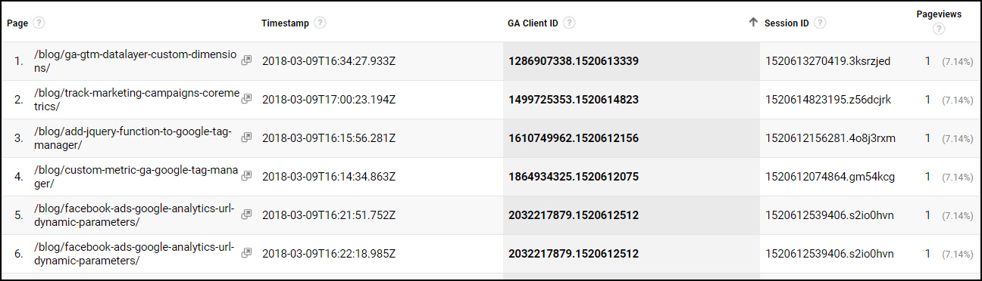
Clickstream Data
https://mixedanalytics.com/blog/quickstart-google-analytics-clickstream-data/

Slide 3
Properties of a Clean Data Set
Each sample is one row
Each column represents a single, scalar variable
All values are represented consistently (e.g., spelling of state names, format of dates)
Any missing values are noted and handled appropriately
All values in each column have the same types (e.g., categorical, int, float)
All values in each column have the same units (e.g., inches)
Any outlier / unexpected values are noted and handled appropriately

Slide 4
Ingestion and Data Cleaning Steps
Parse the file format to read in the data. At the end of this stage, for each record, you should be able to separate the values belonging to each field
Convert data to consistent representations (e.g., spelling of state names, format of dates)
Handling missing values
Convert values to the right types (e.g., floats, datetimes, categorical)
Convert values to consistent units (e.g., everything in inches)
Identify outlier or unexpected values

Slide 5
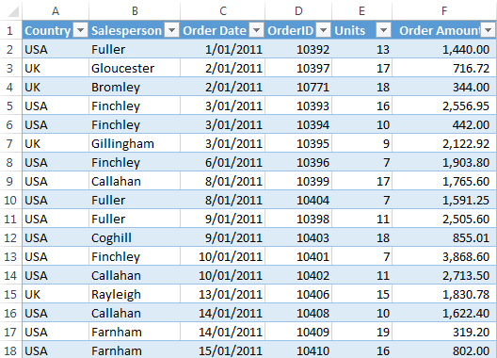
Tabular Data
The easiest data to work with are tabular data
Records are organized into rows
Variables (fields) are organized into columns
Commonly stored in relational databases or spreadsheets
https://www.myonlinetraininghub.com/excel-tabular-data-format

Slide 6
Clean Data Set: Observations are in Rows
https://www.myonlinetraininghub.com/excel-tabular-data-format

Slide 7
Clean Data Set: One Variable Per Column
Each column represents a single, scalar variable
Int, Float, Double, etc.
Categorical
Date, Time, Datetime, Duration
Combined variables are separated
https://www.myonlinetraininghub.com/excel-tabular-data-format

Slide 8
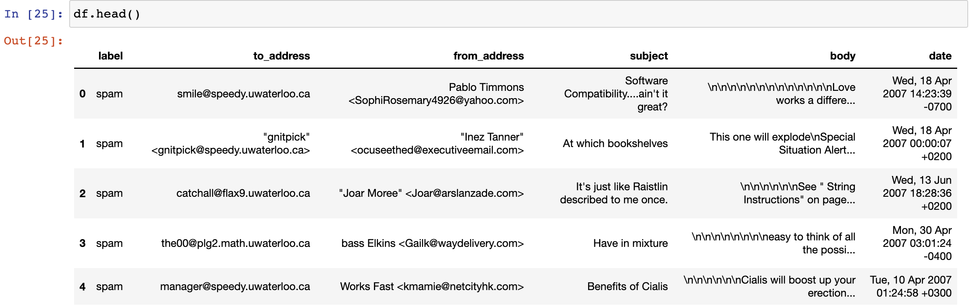
head() Method

Slide 9
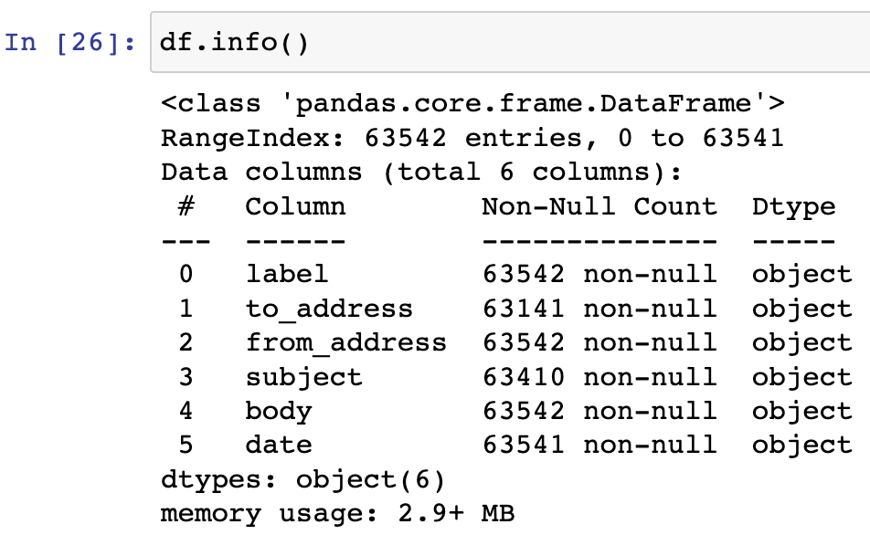
info() Method
The info() method displays column info (e.g., name, type, nulls)
Are there the expected number of 63,542 rows (entries)?
Do the columns have the expected types?
Why is date not a DateTime or label a categorical?

Slide 10
Compound Variables Example
Assume that a table of data with descriptions of cars describes the transmissions using strings like so:
“6-cyl, RWD, conventional”
“4-cyl, AWD, hybrid”
The strings should be separated into three separate variables:
Number of cylinders (int)
Drive type (categorical)
Fuel source type (categorical)

Slide 11
Ingestion and Data Cleaning Steps
Parse the file format to read in the data. At the end of this stage, for each record, you should be able to separate the values belonging to each field
Convert data to consistent representations (e.g., spelling of state names, format of dates)
Handling missing values
Convert values to the right types (e.g., floats, datetimes, categorical)
Convert values to consistent units (e.g., everything in inches)
Identify outlier or unexpected values

Slide 12
Clean Data Set: Consistent Value Representations
The values for each variable have consistent representations
Spelling
Capitalization
Format of dates
Whole or decimal numbers
If not, the representations need to be unified
https://www.myonlinetraininghub.com/excel-tabular-data-format

Slide 13
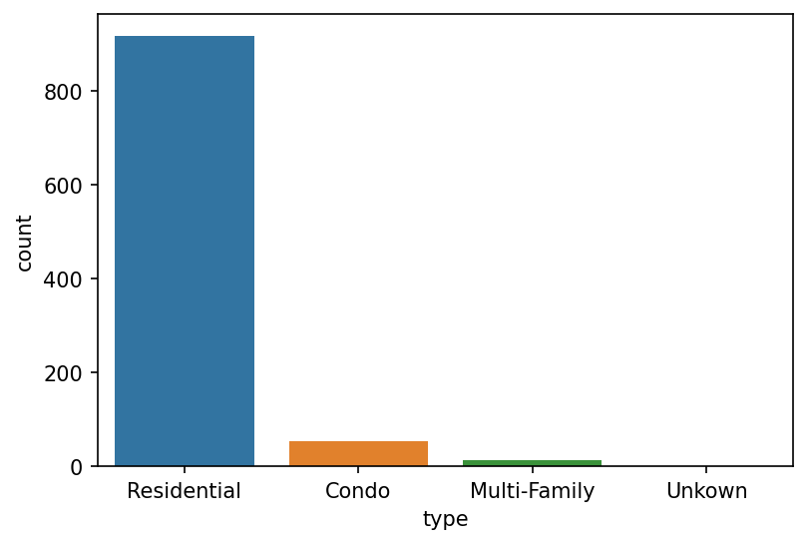
Sanity Checks / Data Quality
Are there unexpected values?
Are the categories spelled correctly?
"Unkown" is misspelled

Slide 14
Value Representation Unification
State Names
Mississippi
MS
Miss
Number of bathrooms
1
1.0
1.5
1.75
2
Road Types
Drive
Dr
Street
street
st
St
ST

Slide 15
Checking Representations
Looking at a set of all values is a good way to determine
the number of unique values – higher or lower than expected?
if there are multiple spellings or values used to represent the same thing
String when you expect numerical type?
Pandas and others will not convert a column to an int if it finds a string in the column
If the values look numerical but the column type is "object", there may be an odd value there

Slide 16
Ingestion and Data Cleaning Steps
Parse the file format to read in the data. At the end of this stage, for each record, you should be able to separate the values belonging to each field
Convert data to consistent representations (e.g., spelling of state names, format of dates)
Handling missing values
Convert values to the right types (e.g., floats, datetimes, categorical)
Convert values to consistent units (e.g., everything in inches)
Identify outlier or unexpected values

Slide 17
What are Missing Values?
Missing values are simply those that were not observed or the result of data corruption
For example, maybe a basketball player's height was
never measured
written down in illegible handwriting
Maybe a server crashed and the logs were lost
User entered invalid data on an online form that didn't have sufficient validation checks

Slide 18
Random or Meaningful?
In some cases, missing values have meaning
E.g., in your mailbox events, some messages will be marked as spam and others will not
when you join the emails with the events, you will get null values in the resulting table
In that case, a known value means the message is spam, while a null value indicates that the message is not spam
Important to distinguish between these cases
If the missing values are not random, we say that they are missing at random

Slide 19
Examples of Missing Value Representations
Strings:
A placeholder value (e.g., "?") or a null (None)
Categorical variables:
A placeholder value (e.g., "unknown")
Floats / Doubles
Represented by NaNs or a placeholder value (0.0)
Ints
Do not allow NaNs so a place holder value (0 or -1)

Slide 20
Why Are Missing Values Problematic?
Missing values can lead to bias in models
Models can interpret the missing value as a signal
Missing values can cause problems with numerical calculations
Most libraries like scikit-learn are not able to handle NaNs or other missing values
The NaNs propagate and prevent a modeling from training or predicting
Missing values can crash pipelines
E.g., think of NullPointerExceptions in Java when you assume a variable references a String object but instead references null

Slide 21
info() method
The info() method displays column info (e.g., name, type, nulls)
There are 63,542 rows (entries)
The to_address, subject, and date columns have fewer than 63,452 non-null entries
There are records with missing values

Slide 22
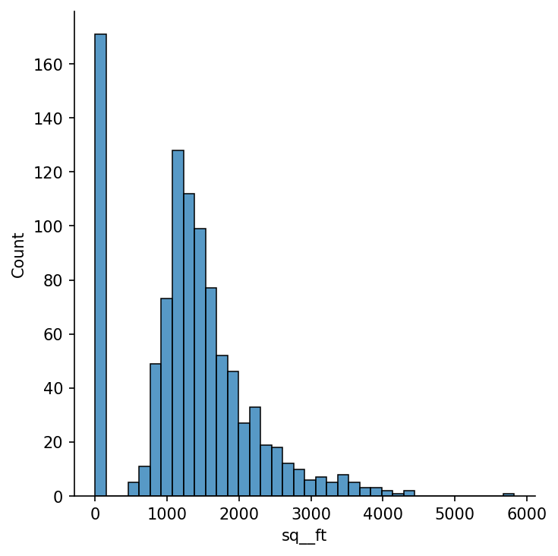
Sanity Checks / Data Quality
Are values within expected ranges?
Square footage should not be zero or negative -- why?

Slide 23
Handling Values Missing at Random
All missing or placeholder values have been identified and documented
Values missing at random are handled by:
Replacing with an average or most common value
Removing the associated records
Left alone (placeholders replaced with a null or none object)
https://www.myonlinetraininghub.com/excel-tabular-data-format

Slide 24
Ingestion and Data Cleaning Steps
Parse the file format to read in the data. At the end of this stage, for each record, you should be able to separate the values belonging to each field
Convert data to consistent representations (e.g., spelling of state names, format of dates)
Handling missing values
Convert values to the right types (e.g., floats, datetimes, categorical)
Convert values to consistent units (e.g., everything in inches)
Identify outlier or unexpected values

Slide 25
Clean Data Set: Each Variable Has One Scalar Type
Each variable uses a single, well-defined type
Int, Float, Date, DateTime, etc.
All values in the column are encoded as that type
No String objects in a column that is expected to be ints
https://www.myonlinetraininghub.com/excel-tabular-data-format

Slide 26
Choosing the Right Types
Text (String)
Numerical
Integer (int32, int64)
Float (float32, float64)
Boolean (bool)
Categorical
Date / Times
timedelta64[ns]
datetime64[ns]
Timestamp

Slide 27
Numerical Types
Integer types do not have values indicating NaN (missing value or result of divide by 0)
It may be advantageous to represent an integer column as a float or double so missing values can be represented by NaN instead of a placeholder like -1 which could be missed by a user

Slide 28
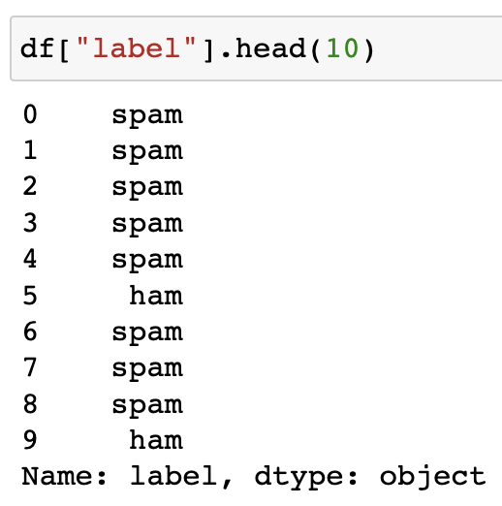
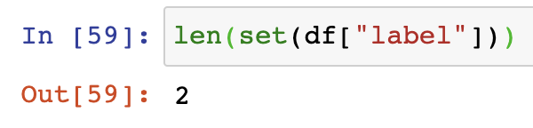
Should It Be Categorical?

Slide 29
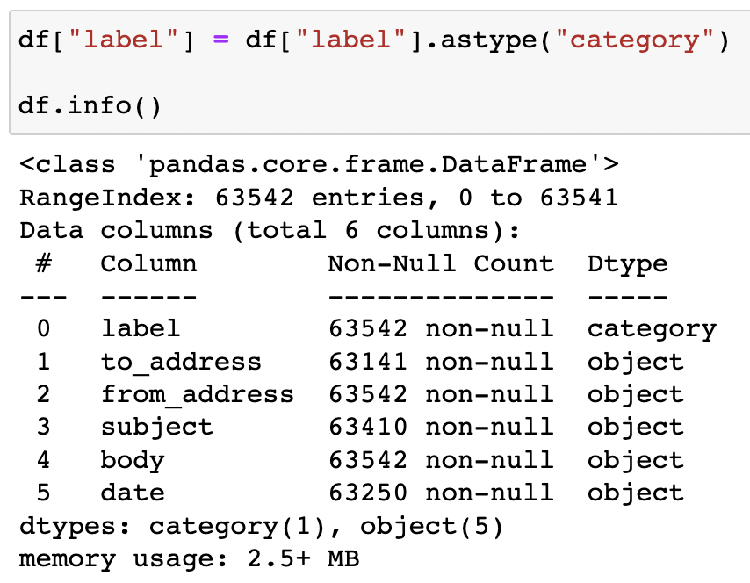
Should It Be Categorical?

Slide 30
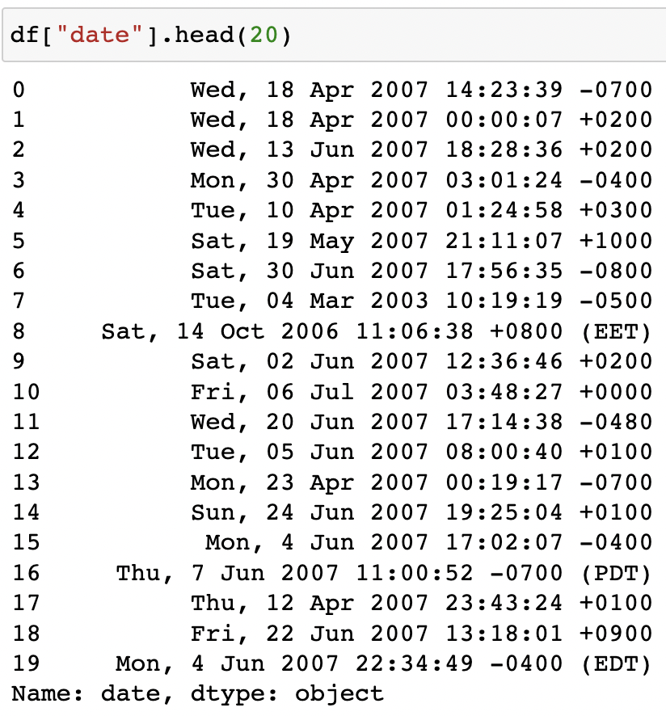
Multiple Representations
Not all values can be easily unified at an earlier stage
A common example are dates and times. Dates follow several patterns:
YYYY-MM-DD
MM-DD-YY
We need to handle multiple representations when parsing them

Slide 31
Ingestion and Data Cleaning Steps
Parse the file format to read in the data. At the end of this stage, for each record, you should be able to separate the values belonging to each field
Convert data to consistent representations (e.g., spelling of state names, format of dates)
Handling missing values
Convert values to the right types (e.g., floats, datetimes, categorical)
Convert values to consistent units (e.g., everything in inches)
Identify outlier or unexpected values

Slide 32
Clean Data Set: Values for Each Variable Are in the Same Units
All values for a given variable are expressed in the same unit
Length: Inches, Feet, Meters
Duration: Seconds, Minutes, Hours
Weight: pounds
Currency: USD, Yen
Dates: time zones
https://www.myonlinetraininghub.com/excel-tabular-data-format

Slide 33

NASA Mars Climate Orbiter
$327.6 million project
Crashed when landing on Mars
NASA engineers used international scientific (SI) units
Lockheed Martin engineers used U.S. customary (Imperial) units
Software did not model unit types (meters, feet), just numerical types (floats, ints)

Slide 34
Ingestion and Data Cleaning Steps
Parse the file format to read in the data. At the end of this stage, for each record, you should be able to separate the values belonging to each field
Convert data to consistent representations (e.g., spelling of state names, format of dates)
Handling missing values
Convert values to the right types (e.g., floats, datetimes, categorical)
Convert values to consistent units (e.g., everything in inches)
Identify outlier or unexpected values

Slide 35
Clean Data Set: Unexpected or Outlier Values
All unexpected or outlier values have been identified and documented
House prices that are in thousands of dollars when you expected hundreds of thousands or millions (data entry error)
A column of US state names contains something other than US state names (e.g., name of a state in a different country)
https://www.myonlinetraininghub.com/excel-tabular-data-format

Slide 36
Sort by column, look at first and last few

Slide 37
Sanity Checks / Data Quality
Are values within expected ranges?
Square footage should not be zero or negative -- why?

Slide 38
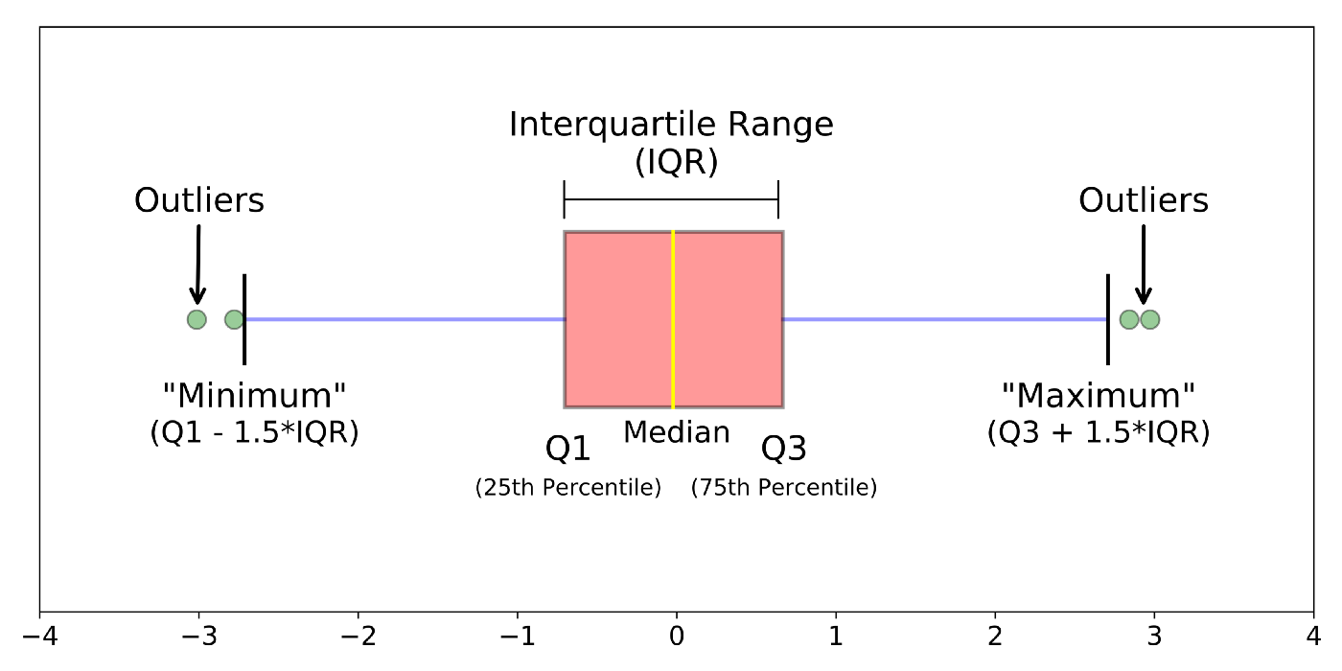
Interquartile Range

Slide 39
Properties of a Clean Data Set
Each sample is one row
Each column represents a single, scalar variable
All values are represented consistently (e.g., spelling of state names, format of dates)
Any missing values are noted and handled appropriately
All values in each column have the same types (e.g., categorical, int, float)
All values in each column have the same units (e.g., inches)
Any outlier / unexpected values are noted and handled appropriately

